Slide 1
Financial Analysis Dashboard
Data Analyst Internship- Task 3
Submitted BY- Himani Khawashi
Tool used: Microsoft Power Bi
Dataset: Financial Sample Dataset (Kaggle)

Slide 2
Project Overview
The objective of this project was to design an interactive financial dashboard that enables business stakeholders to monitor key financial KPIs, analyse sales performance, evaluate profitability, and support data-driven decision-making.
Dashboard Features
KPI Cards for Sales, Orders, Profit, Profit Margin and Discount
Interactive Year and Country slicers
Time-Series Analysis
Country-wise Performance Analysis
Product-wise Sales Analysis
Segment-wise Profitability Analysis
Discount Band Analysis

Slide 3
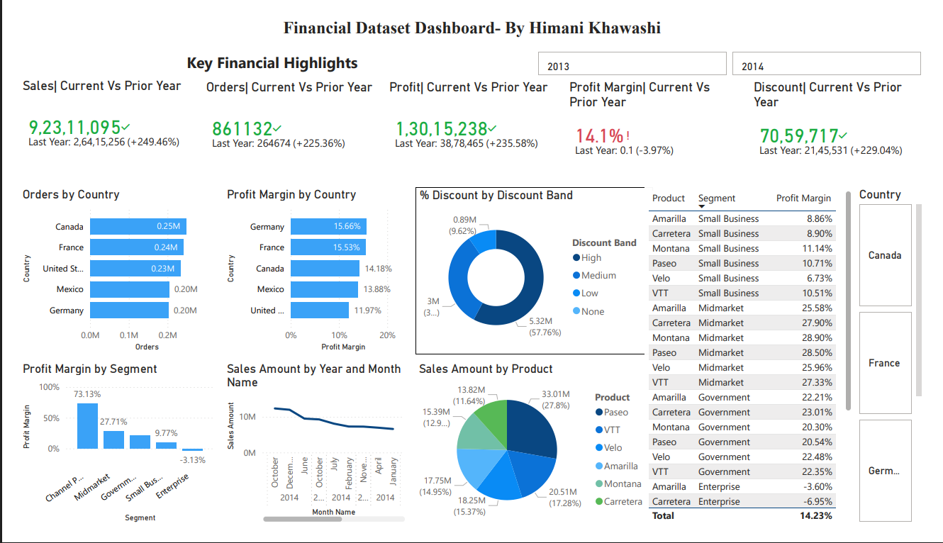

Slide 4
Dashboard Components
Sales KPI
Orders KPI
Profit KPI
Profit Margin KPI
Discount KPI
Orders by Country
Profit Margin by Country
Discount Band Distribution
Profit Margin by Segment
Monthly Sales Trend Sales by Product
Profit Margin Details Table
Interactive Year & Country Slicers

Slide 5
Key Insights
Business Insights
Sales Performance
Total Sales exceeded 92.3 million, indicating strong overall business performance.
Profitability
Overall Profit reached approximately 13.0 million.
Overall Profit Margin is 14.1%.
Country Performance
Germany recorded the highest profit margin.
Canada generated the highest number of orders.

Slide 6
Product Analysis
Paseo contributed the highest sales among all products.
VTT and Velo also performed strongly.
Segment Analysis
Channel Partners achieved the highest profit margin.
Enterprise segment showed the lowest profitability.
Discount Analysis
High Discount Band accounted for the largest percentage of discounts.
Trend Analysis
Monthly sales fluctuated throughout the year with strong growth toward the end of the year.

Slide 7
Business Value
Dashboard Benefits
This dashboard helps business stakeholders to:
Monitor financial KPIs in real time.
Compare performance across countries.
Identify profitable products and business segments.
Analyze monthly sales trends.
Evaluate the impact of discount strategies.
Support strategic business decisions using interactive filters.

Slide 8
Conclusion
Successfully designed an interactive financial dashboard using Power BI.
Visualized key business KPIs including Sales, Orders, Profit, Profit Margin, and Discount.
Enabled interactive analysis through Year and Country slicers.
Performed time-series analysis to identify monthly sales trends.
Compared financial performance across countries, products, and business segments.
Created a clean, user-friendly dashboard to support data-driven decision-making.
Demonstrated practical skills in Power BI, DAX, data visualization, and dashboard design.

